Slide 1
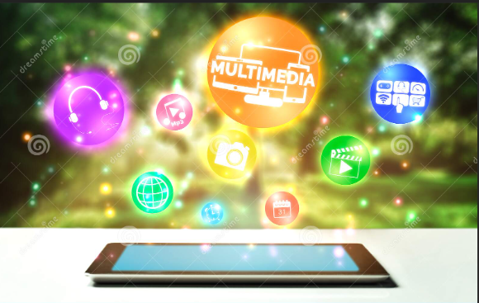
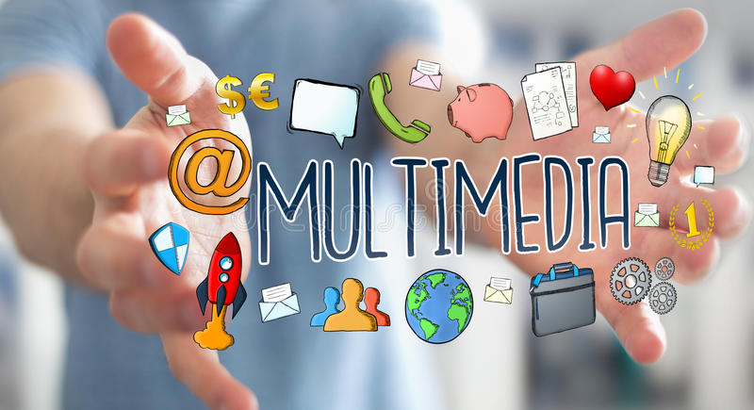
MULTIMEDIA
Multimedia refers to the computer-assisted integration of text, drawings, still and moving images(videos) graphics, audio, animation, and any other media in which any type of information can be expressed, stored, communicated, and processed digitally.

Slide 2
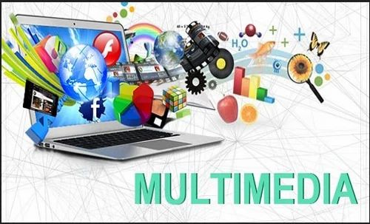
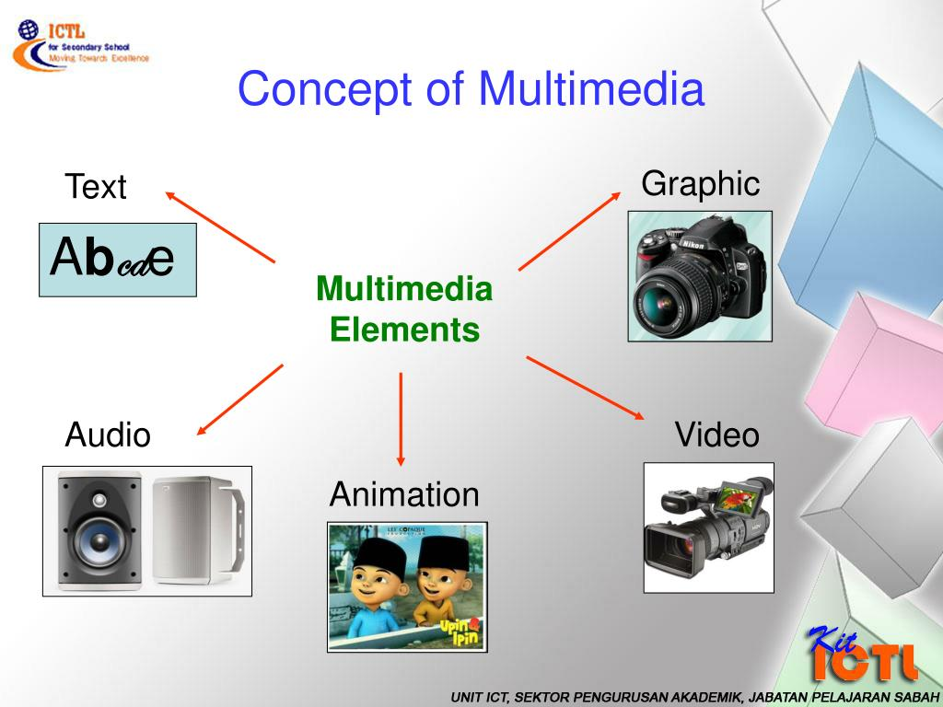
Components of Multimedia
Multimedia consists of the following 5 components:

Slide 3
Characters are used to form words, phrases, and paragraphs in the text.
Text appears in all multimedia creations of some kind. The text can be in a variety of fonts and sizes to match the multimedia software’s professional presentation.
Graphics
Non-text information, such as a sketch, chart, or photograph, is represented digitally.
The use of visuals in multimedia enhances the effectiveness and presentation of the concept. Windows Picture, Internet Explorer, and other similar programs are often used to see visuals. Adobe Photoshop is a popular graphics editing program that allows you to effortlessly change graphics and make them more effective and appealing.
Text

Slide 4
Animations
A sequence of still photographs is being flipped through.
It’s a set of visuals that give the impression of movement. Animation is the process of making a still image appear to move. The following are some of the most regularly used animation viewing programs: Fax Viewer, Internet Explorer, etc.
Video
Photographic images that appear to be in full motion and are played back at speeds of 15 to 30 frames per second.
The following programs are widely used to view videos: Real Player, Window Media Player, etc.
Audio
Any sound, whether it’s music, conversation, or something else. Sound is the most serious aspect of multimedia, delivering the joy of music, special effects, and other forms of entertainment.
The following programs are widely used to view videos: Real Player, Window Media Player, etc.

Slide 5
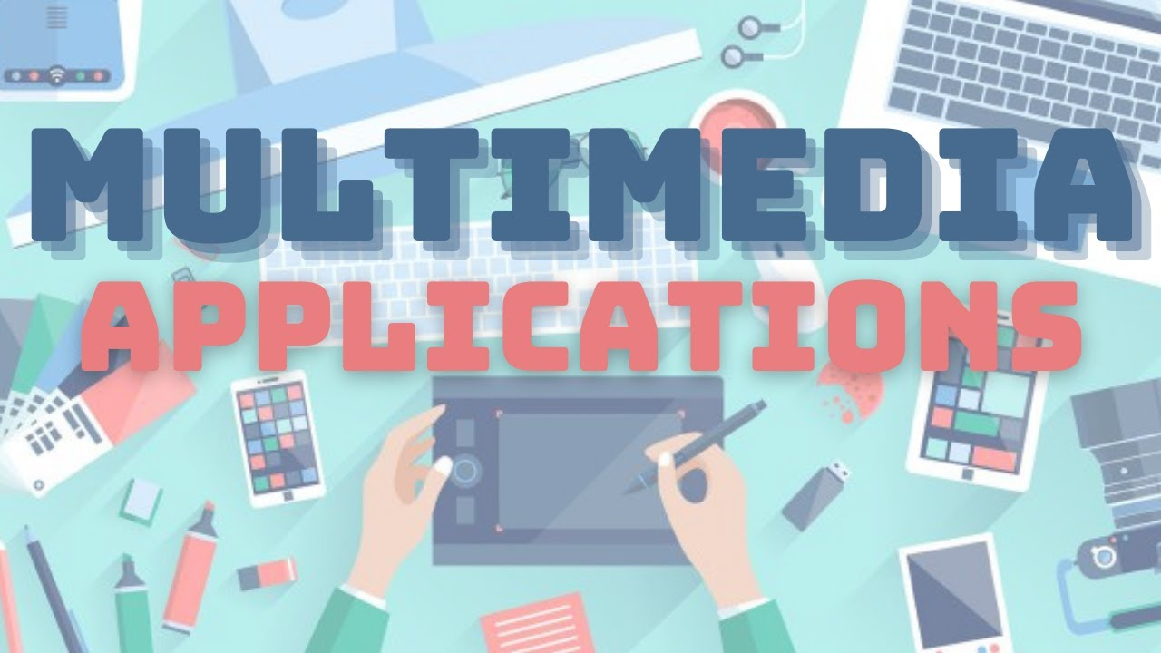
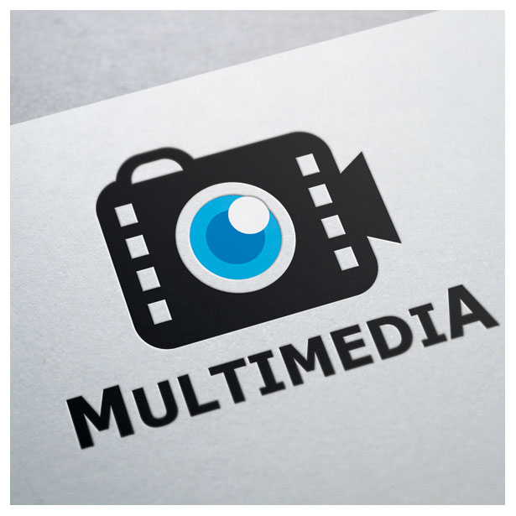
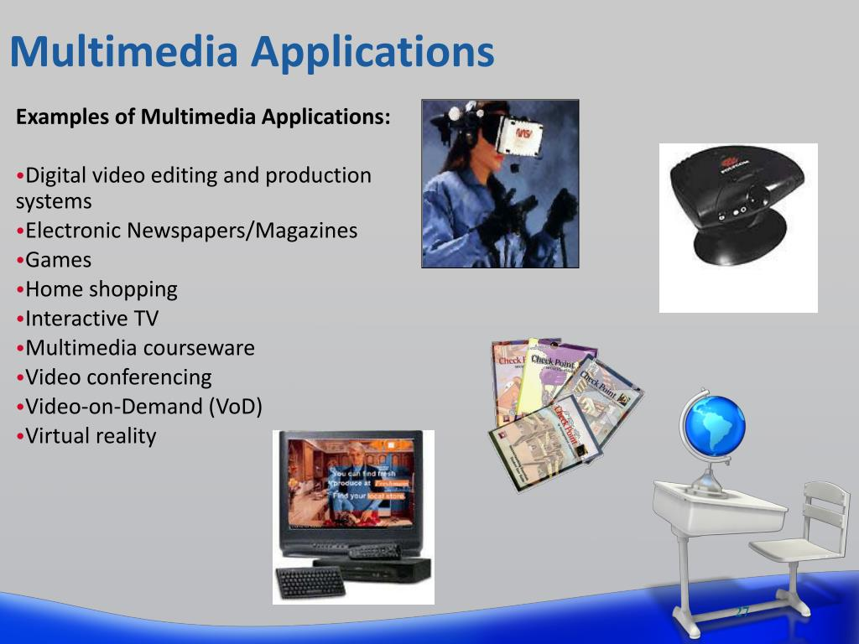
Applications of Multimedia
Multimedia indicates that, in addition to text, graphics/drawings, and photographs, computer information can be represented using audio, video, and animation. Multimedia is used in:

Slide 6
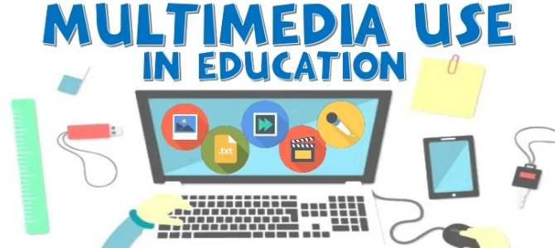
Education
In the subject of education, multimedia is becoming increasingly popular. It is often used to produce study materials for pupils and to ensure that they have a thorough comprehension of various disciplines. Edutainment, which combines education and entertainment, has become highly popular in recent years. This system gives learning in the form of enjoyment to the user.

Slide 7
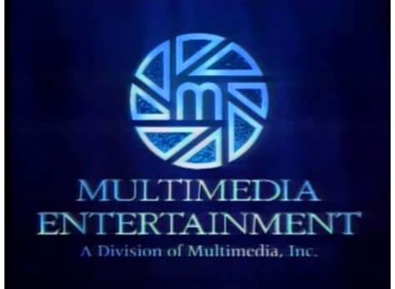
Entertainment
The entertainment sector makes extensive use of multimedia.
It’s particularly useful for creating special effects in films and video games.
The most visible illustration of the emergence of multimedia in entertainment is music and video apps.
Video games are more interesting because of the integrated audio and visual effects.

Slide 8

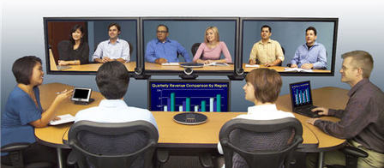
Business
Marketing, advertising, product demos, presentation, training, networked communication, etc. are applications of multimedia that are helpful in many businesses. The audience can quickly understand an idea when multimedia presentations are used.
It gives a simple and effective technique to attract visitors’ attention and effectively conveys information about numerous products.

Slide 9
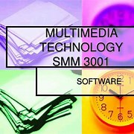

Technology and Science
In the sphere of science and technology, multimedia has a wide range of applications. It can communicate audio, films, and other multimedia documents in a variety of formats. Only multimedia can make live broadcasting from one location to another possible.
It is beneficial to surgeons because they can rehearse intricate procedures such as brain removal and reconstructive surgery using images made from imaging scans of the human body. Plans can be produced more efficiently to cut expenses and problems.

Slide 10

Fine Arts
Multimedia artists work in the fine arts, combining approaches employing many media and incorporating viewer involvement in some form.
Digital artist is a new word for these types of artists.

Slide 11
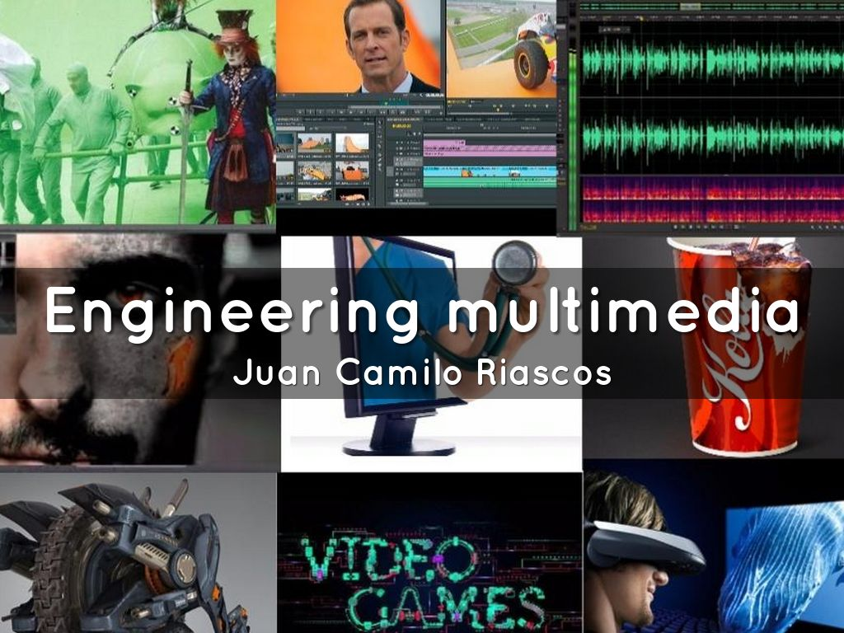

Engineering
Multimedia is frequently used by software engineers in computer simulations for military or industrial training.
It’s also used for software interfaces created by creative experts and software engineers in partnership.

Slide 12
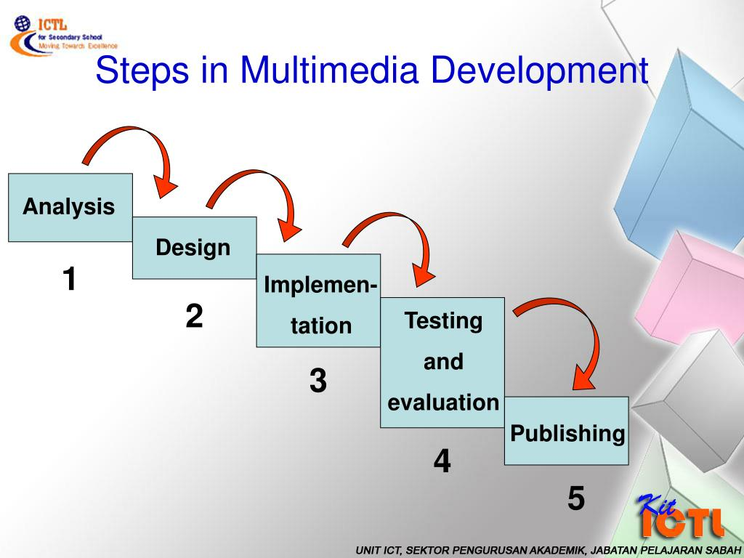
Recent DevelopmentS in multimedia
Emerging multimedia technologies for e-learning:
Multimedia technologies broadly refer to the development and the use of various types of media and communication technologies to enhance content visualization and user interaction. Multimedia technology integration is becoming a core part in the development of e-learning technologies

Slide 13
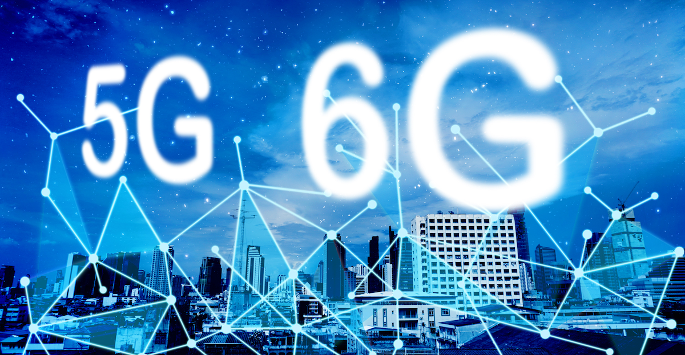
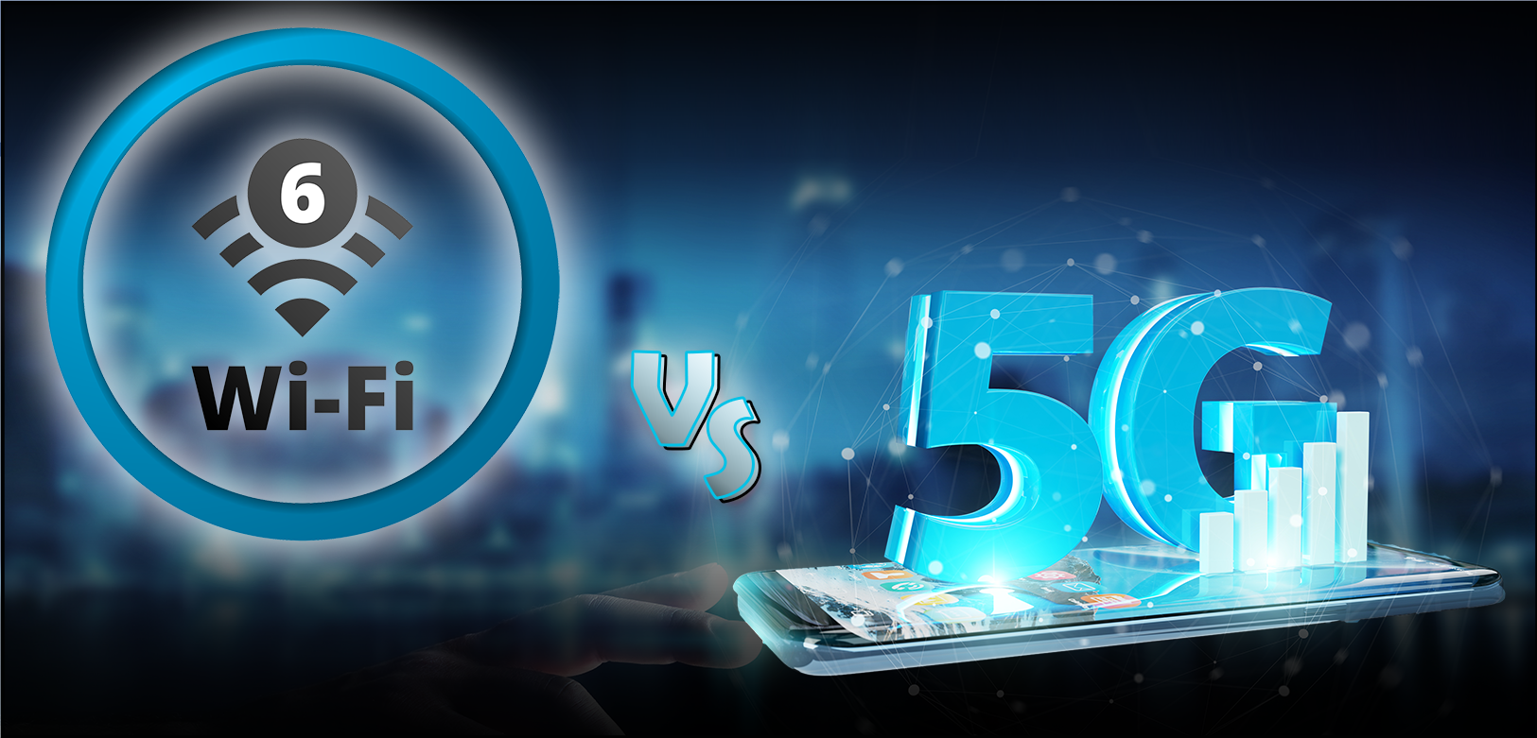
5G & Wi-Fi 6
Super fast, wireless technology is here with 5G data networks ready to enhance phone speed. It’s also poised to help usher in mainstream virtual and augmented reality. We could see data delivered at nearly 10 gigabits per second, making everything from live streaming video to exploring augmented reality a flawless experience. 5G devices are still being developed and rolled out, but carriers from AT&T to Verizon are already competing to be the marketplace leaders of the 5G revolution.

Slide 14

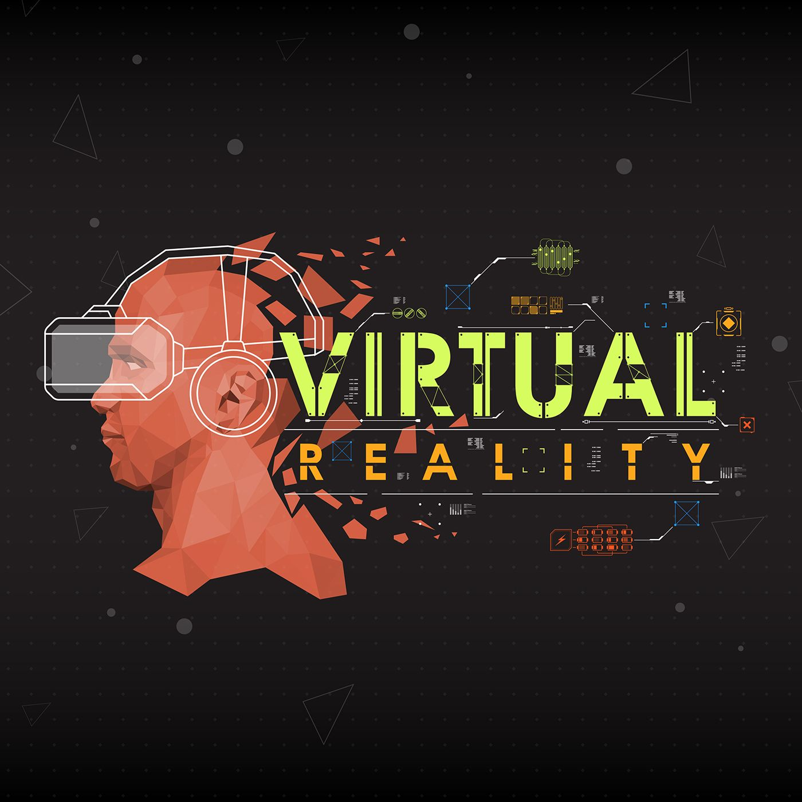
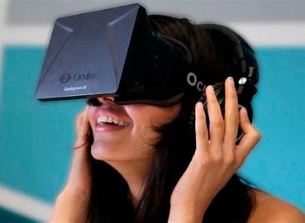
Virtual Reality (VR)
The ultimate level of news interaction? Being right in the center of the action. VR promises to transport the viewer into the middle of an experience to form a better connection to the story.
The New York Times VR app is a good example of VR, and its launch was accompanied by sending 1.2 million Google cardboard viewers to subscribers. The all-engrossing VR video experience builds a deeper level of connectedness and empathy with news stories.

Slide 15

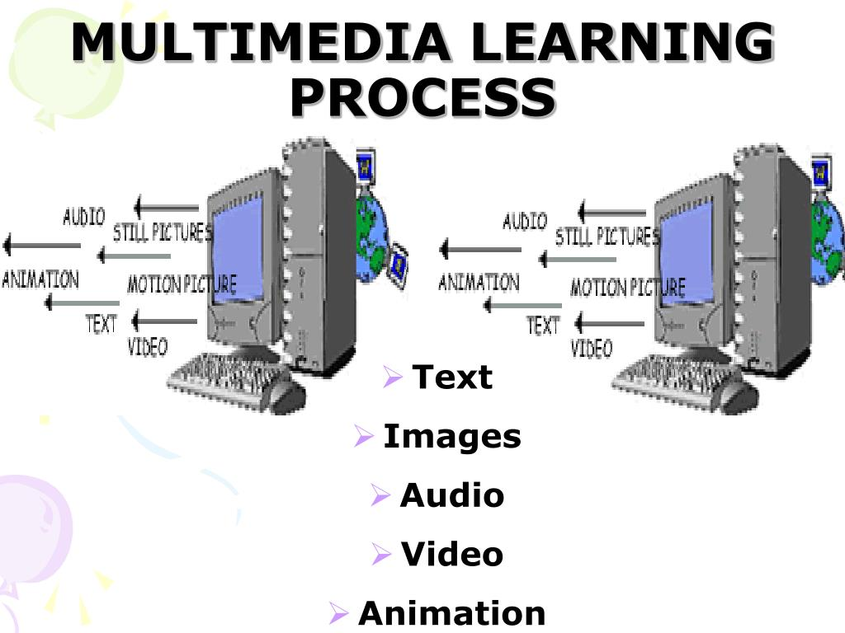
Media changing the learning process
The main objective of media is to provide channels for the delivery of various forms of contents. With the availability of new media types in recent years, substantial changes have been made to the student learning process.

Slide 16


Social outreach apps
Content creators can go beyond the usual suspects of Facebook, Twitter, and Instagram to get consumer perspectives. Social outreach apps bring a fresh take on how the media industry engages with its audience. Q&A allows anyone to provide video answers to questions, which enables journalists to get authentic video interviews from as many people as possible, without being physically present.

Slide 17
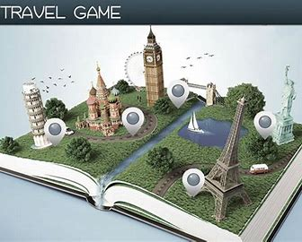
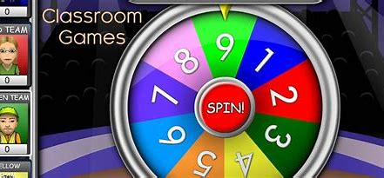
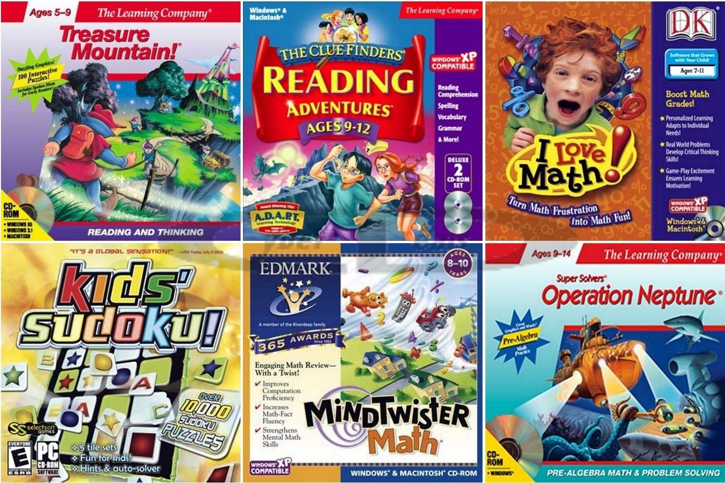
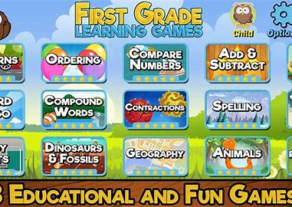
Games as a medium for e-learning
Game-based learning (GBL) research is becoming popular recently, as researchers find that the paradigm can significantly motivate students to learn.
GBL is supported by a set of technologies, including multimedia communication, computer graphics, human-computer interaction, and ubiquitous computing
. The ultimate goal of GBL is to turn the learning process into a combination of entertainment, visual-oriented and interaction-based tasks, through which students may gain a deeper understanding in their studies.

Slide 18

Social networks as a medium for e-learning
Social technologies (or social media) refer to the use of communication channels, suchas the Internet or mobile networks, for establishing and maintaining user groups/communities, where information sharing and social interaction are supported .
. In social interaction, users may be grouped under various forms of communities based on events
or situations

Slide 19

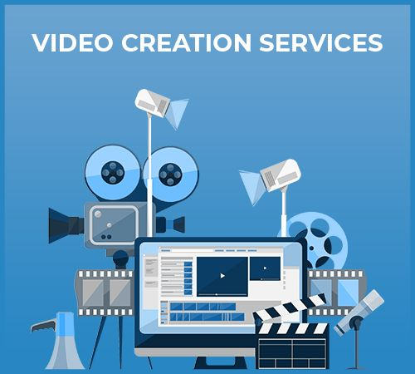

Video creation technology
Video may be the king of content for media brands, but publishing enough videos to satisfy viewers is no easy task. The best way to help your team supply the ever-growing demand for video? Investing in video creation technology – whether that means using an online platform like the Wibbitz Studio.

Slide 20

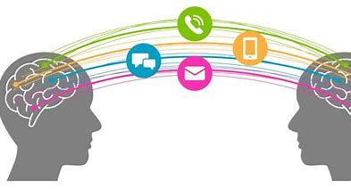

Communication technologies as a medium for e-learning
The development of communication technologies, such as mobile devices and RFID (radio frequency identification), is fundamental to providing more convenient ways for instructors and learners to interact and collaborate with each other.
It facilitates the delivery of learning
materials and improves the accessibility of e-learning applications.

Slide 21


